Slide 1
Digital Portfolio
STUDENT NAME: K. Santhosh
REGISTER NO AND NMID: 222/as222408861
DEPARTMENT: BSC
COLLEGE: Madha art and science COLLEGE/ Madras UNIVERSITY

Slide 2
PROJECT TITLE
Pixels &passion:my portfolio

Slide 3


AGENDA
Problem Statement
Project Overview
End Users
Tools and Technologies
Portfolio design and Layout
Features and Functionality
Results and Screenshots
Conclusion
Github Link
3/21/2024 Annual Review

Slide 4

PROBLEM STATEMENT
Traditional resumes and printed documents often fail to showcase the creativity, skills, and projects of a student in an interactive way. Employers and recruiters need a quick, accessible, and engaging way to evaluate candidates.

Slide 5

PROJECT OVERVIEW
This project is a personal digital portfolio website designed to highlight academic details, technical skills, projects, and achievements in a professional and visually appealing manner. It provides an online presence for the student, making it easier for recruiters and peers to connect.

Slide 6

WHO ARE THE END USERS?
Recruiters / Employers – to view skills and projects
Faculty & Mentors – to track student work
Peers & Collaborators – to connect for projects
Self – to showcase achievements

Slide 7

TOOLS AND TECHNIQUES
HTML: to navigate and shows the contact
CSS: It shows the colour variations and shape the web page
JAVASCRIPT: Make a pop message to notify about the web page

Slide 8
POTFOLIO DESIGN AND LAYOUT
My profile :
1. Header / Navbar
Sticky navigation bar at the top.
2. Hero / Profile Section
Full-screen intro with your picture, name, and
taglin
3. About Section
Short paragraph about yourself
4. Projects Section
Grid layout (2 or 3 columns).
Each project in a card:
‹#›

Slide 9
FEATURES AND FUNCTIONALITY
Home page with introduction & photo
About Me section with academic details
Projects section with descriptions & links
Skills showcase with icons/graphics
Contact form with email & social links
Responsive design (works on mobile & desktop)

Slide 10
RESULTS AND SCREENSHOTS
Easy online access to academic & personal profile
Professional design increases visibility with recruiters
Centralized showcase of projects & GitHub links
3/21/2024 Annual Review
‹#›

Slide 11
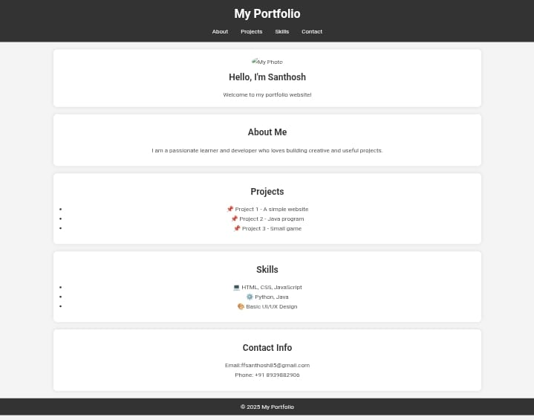

Slide 12
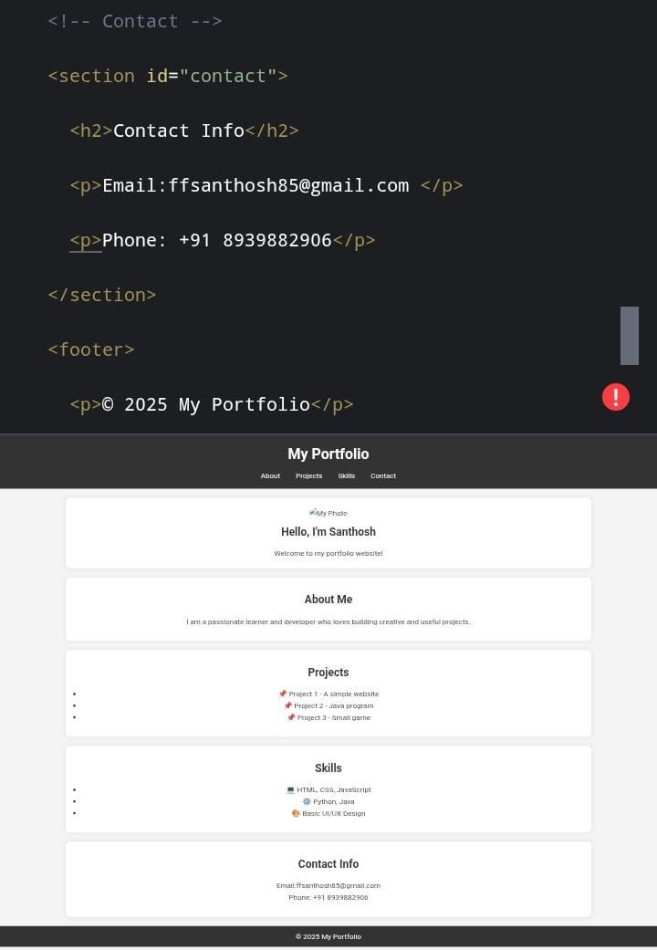

Slide 13
CONCLUSION
Conclusion
The Digital Portfolio Website serves as an online resume + project showcase. It bridges the gap between traditional resumes and modern digital requirements, providing recruiters a convenient, visually rich, and interactive way to evaluate student skills.
‹#›

